Slide 1
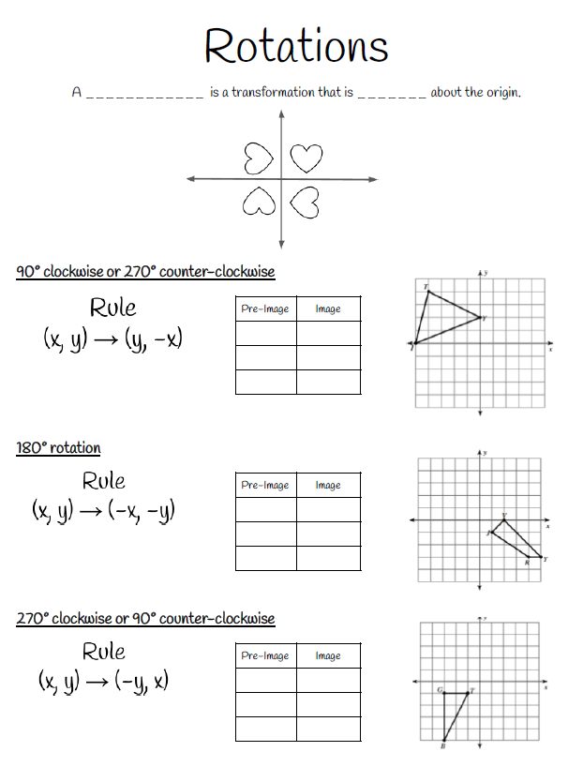
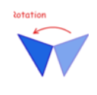
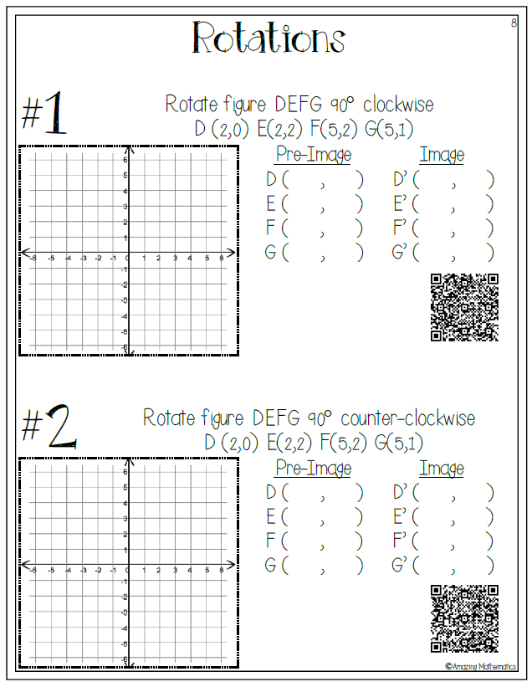
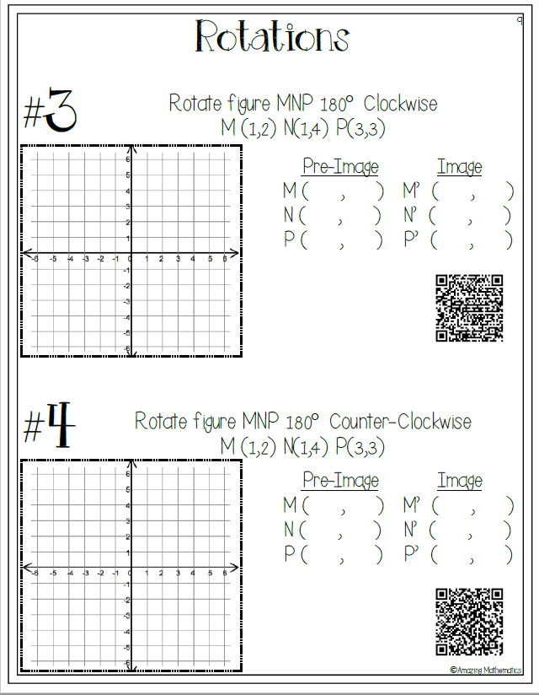
Week 7 (May 4-8) Math 7 and Adv Math 7 Unit 7- Transformations-(Rotations)
MGSE8.G.2, MGSE8.G.3
Learning Target: The students will understand that two figures are congruent if the second can be obtained from the first by a sequence of translations, reflections, and rotations and can describe the effects on these figures by using coordinates.
Websites for Learning:
Rotations
https://www.youtube.com/watch?v=5trp4U4rmLM
Rotations
https://www.youtube.com/watch?v=NhtTKhP3d6s
Notes:
See blank notes attached to BLOG. Print and fill in along with the video.
https://youtu.be/9wDi3-Popfo
Formative Practice:
On-Line Practice
https://www.khanacademy.org/math/geometry/hs-geo-transformations/hs-geo-rotations/e/rotations-1
Practice
https://www.mathgames.com/skill/8.81-rotations-find-the-coordinates
Practice
https://mathbitsnotebook.com/Geometry/Transformations/TRRotationPractice.
Html
Print these from Blog (QR code KEY included)
Show What You Have Learned:
Complete the QUIZZIZ assessment by 5/10 at 9:00 pm-this will be entered in the gradebook.
Ask participants to open
joinmyquiz.comand enter this code
675140
Have some fun: optional
https://www.mathsisfun.com/puzzles/index.html

