Slide 1
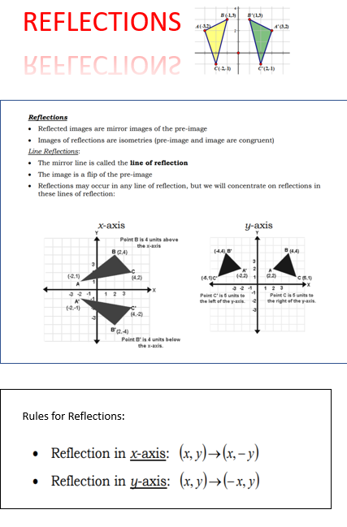
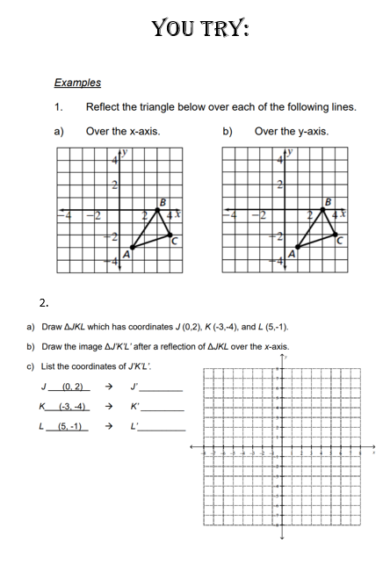
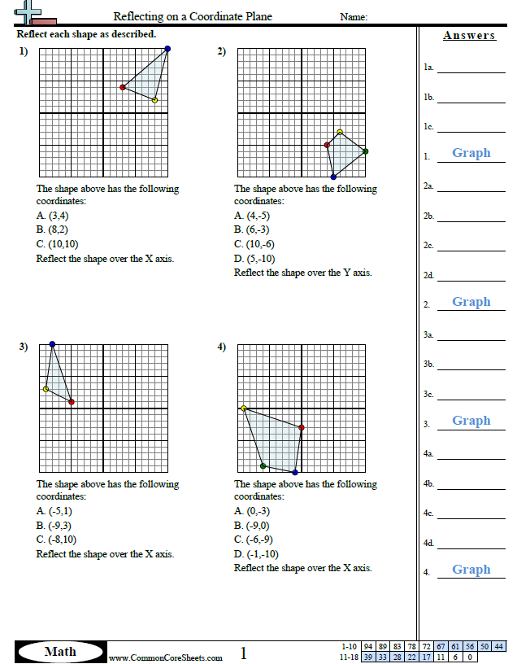
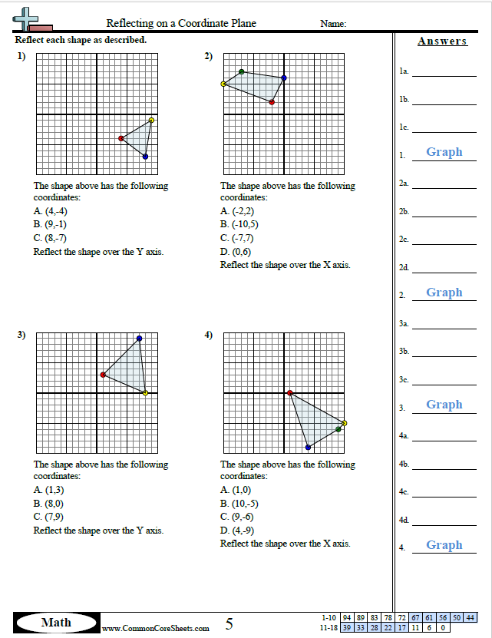
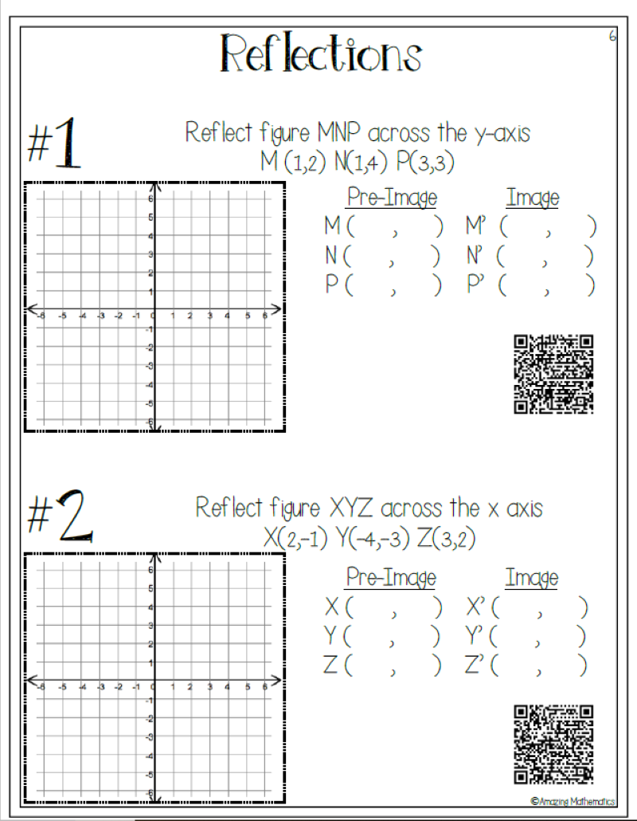
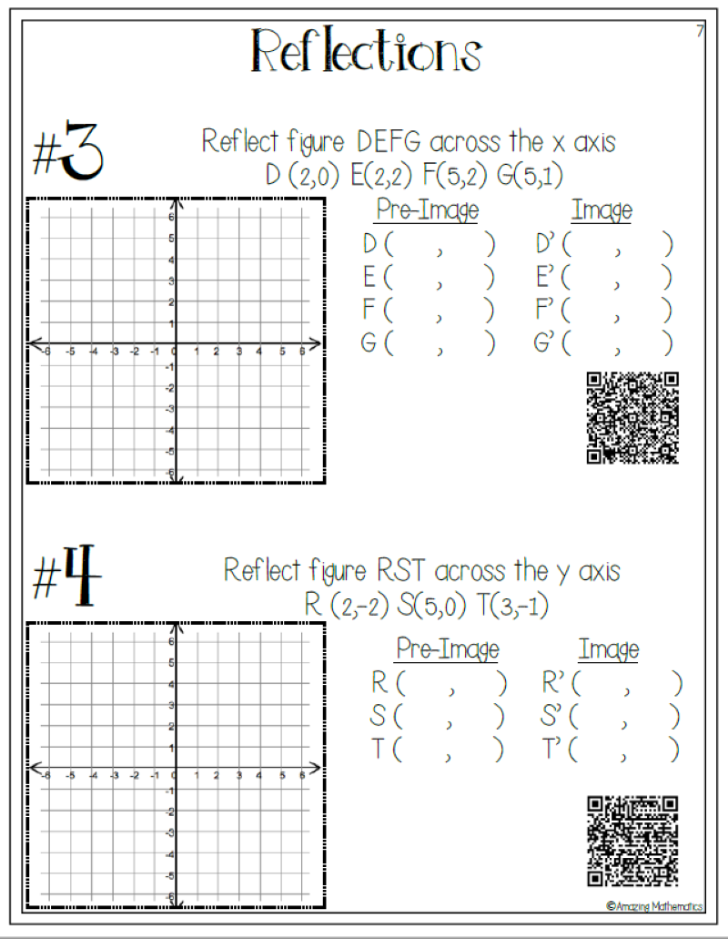
Week 6 (April 27-May 1) Math7 and Adv Math 7 Unit 7- Transformations-(Reflections)
MGSE8.G.2, MGSE8.G.3
Learning Target: The students will understand that two figures are congruent if the second can be obtained from the first by a sequence of translations, reflections, and rotations and can describe the effects on these figures by using coordinates.
Websites for Learning:
Reflections
https://www.youtube.com/watch?v=DerrI1FstO4
Reflections
https://www.khanacademy.org/math/basic-geo/basic-geo-transformations-congruence/basic-geo-reflections/v/reflecting-points
Graph Reflections practice
https://www.mathgames.com/skill/6.119-reflections-graph-the-image
Graph Reflections practice
https://www.khanacademy.org/math/basic-geo/basic-geo-transformations-congruence/basic-geo-reflections/e/reflections-1
Notes:
Print these from Blog-See video below
https://youtu.be/E5h4xjJ8c-U
Formative Practice:
Print these from Blog(KEY included)
Additional Practice- QR Codes with answers
Show What You Have Learned:
Complete the QUIZZIZ assessment by 5/4 at 11:45 pm-this will be entered in the gradebook.
Go to the Quizizz by clicking the link
joinmyquiz.comand enter this code 910874.
Enter your FIRST and LAST NAME and then hit Start Game.
Have some fun: optional
https://www.mathsisfun.com/puzzles/index.html

