Slide 1
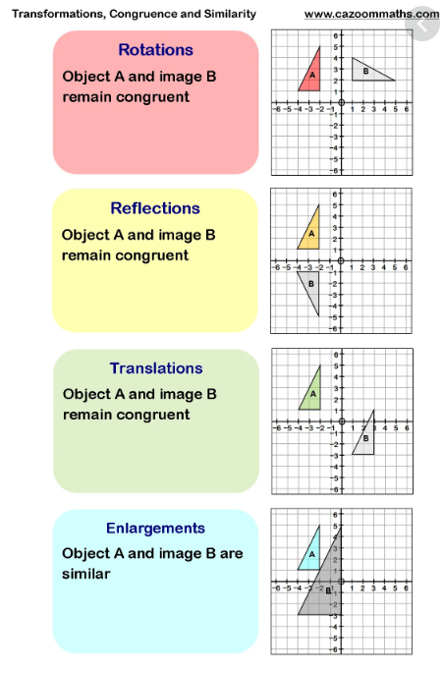
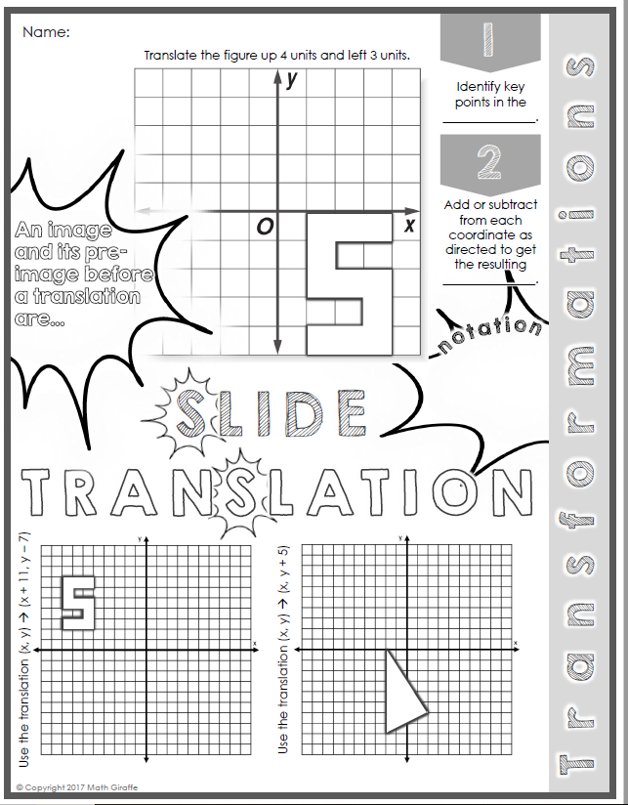
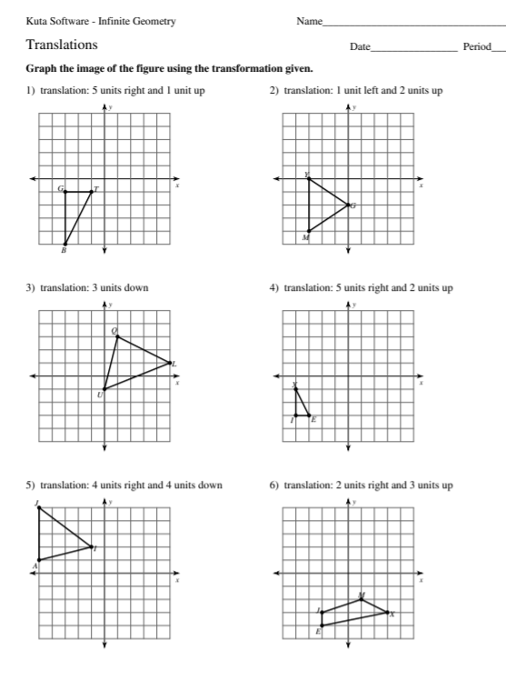
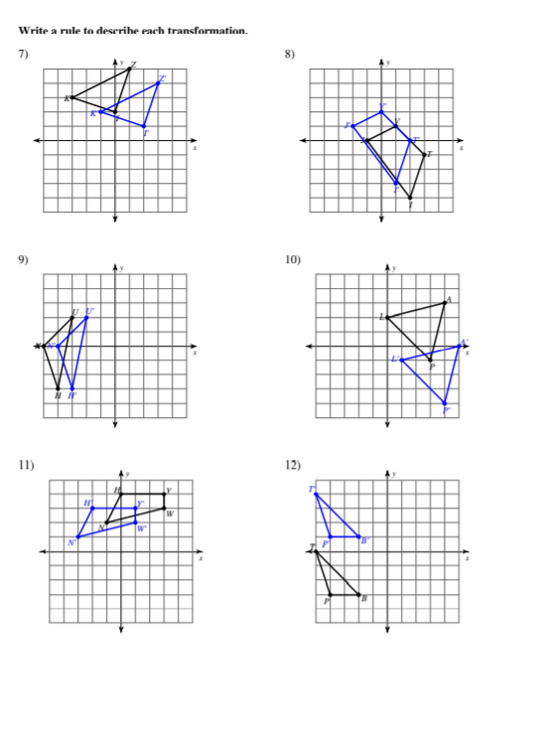
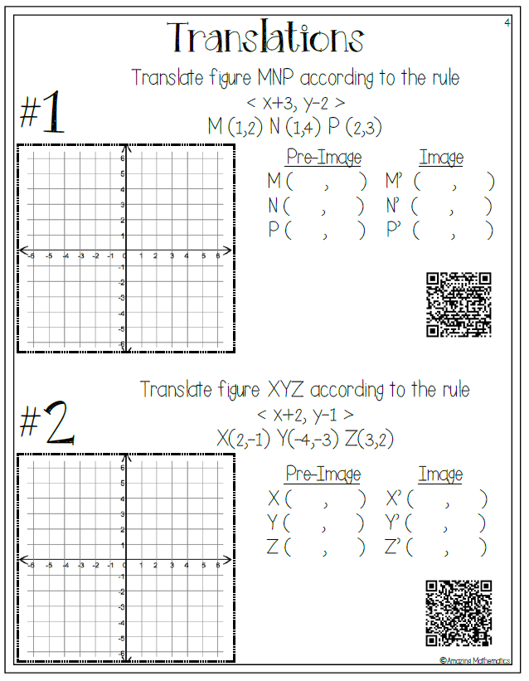
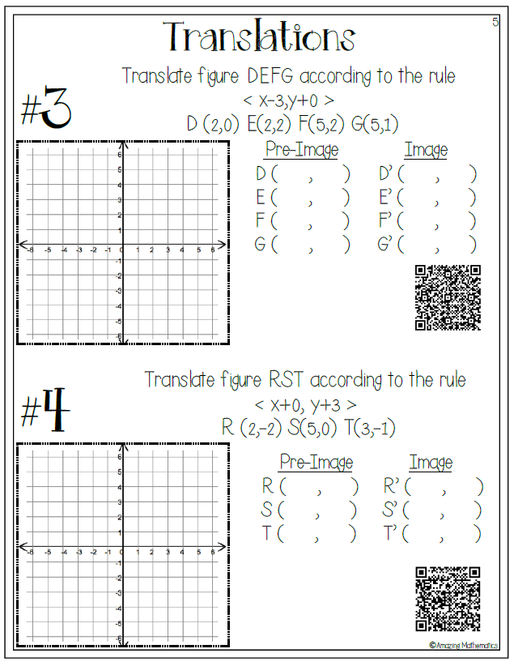
Week 5 (April 20-24) Math7 and Adv Math 7 Unit 7- Transformations-(translations)
MGSE8.G.2, MGSE8.G.3
Learning Target: The students will understand that two figures are congruent if the second can be obtained from the first by a sequence of translations, reflections, and rotations and can describe the effects on these figures by using coordinates.
Websites for Learning:
What are transformations?
https://www.youtube.com/watch?v=86AWyP4UTYM
Translations
https://www.youtube.com/watch?v=j87gj_KH9pA
Translations
https://www.youtube.com/watch?v=Ob3Kzl_tDH0
Translations
https://www.youtube.com/watch?v=gBGW7JbGcI8
Guided Notes:
Print these from Blog-See video below
https://www.youtube.com/watch?v=k24Qi5IgDos
Formative Practice:
Graph Translations
https://www.mathgames.com/skill/8.72-translations-graph-the-image
Print and Practice
(See attachments and key on Blog)
Print and Practice-(check with QR code reader)
Show What You Have Learned:
Take the assessment called “Digital Learning-Translations” through CTLS-this will be entered in the gradebook. Do not log out during the test or it will have to be re-set by your teacher.
https://studentportal.educationincites.com/#/client/gacobb
Have some fun: optional
https://www.mathsisfun.com/puzzles/index.html

