Slide 1
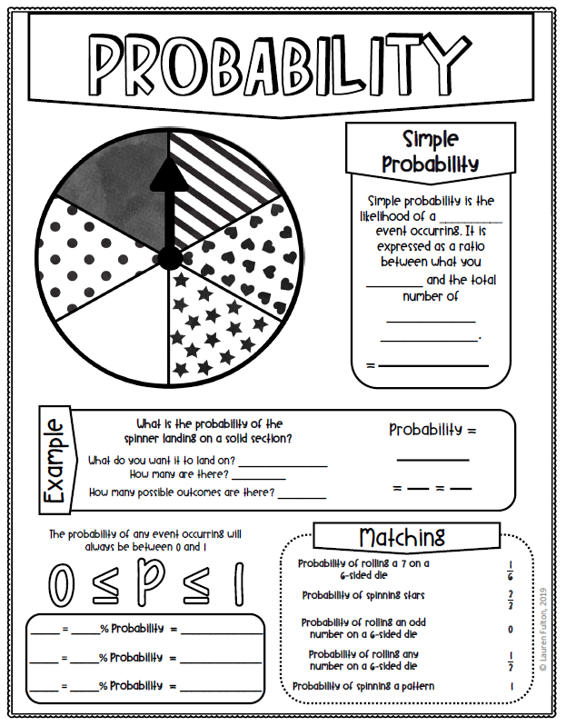
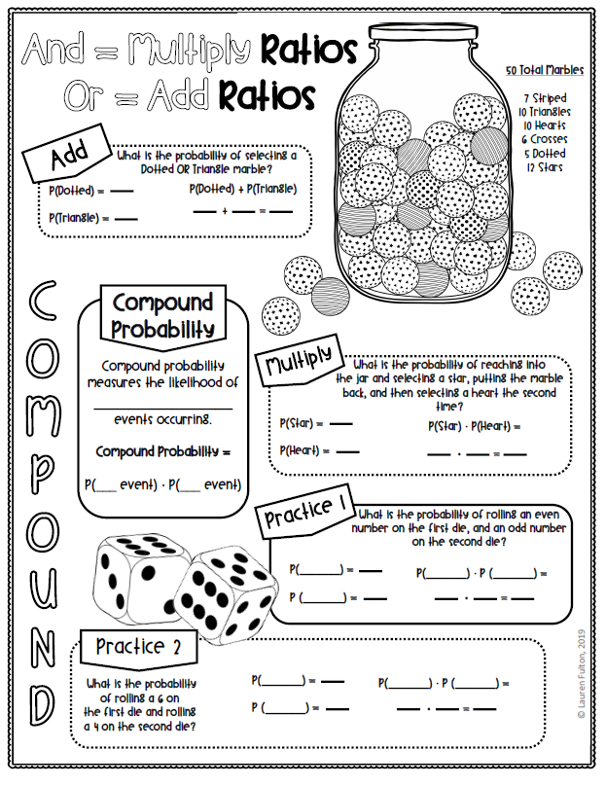
Week 4 (April 13-17) Math7 and Adv Math 7 Unit 6- Probability
MCC7.SP.8a
Learning Target: The students will understand that the probability of a compound event is the fraction of outcomes in the sample space for which the compound event occurs.
Websites for Learning:
Websites for Learning:
Independent Events
https://www.youtube.com/watch?v=xSc4oLA9e8o
Compound Events
https://www.khanacademy.org/math/cc-seventh-grade-math/cc-7th-probability-statistics/cc-7th-compound-events/v/events-and-outcomes-2
Sample Space
https://www.khanacademy.org/math/cc-seventh-grade-math/cc-7th-probability-statistics/cc-7th-compound-events/v/compound-sample-spaces
Compound Probability
https://www.youtube.com/watch?v=XLbMa9ObOPA
Notes:
Print these from BLOG-See video below
https://youtu.be/NMdaJcZD6_s
Formative Practice:
Compound probability
https://www.ixl.com/math/grade-7/probability-of-compound-events
Compound probability
https://www.khanacademy.org/math/cc-seventh-grade-math/cc-7th-probability-statistics/cc-7th-compound-events/e/compound-events
Counting principle
https://www.khanacademy.org/math/cc-seventh-grade-math/cc-7th-probability-statistics/cc-7th-compound-events/e/fundamental-counting-principle
Show What You Have Learned:
Take the quiz through CTLS-this will be entered in the gradebook.
https://studentportal.educationincites.com/#/client/gacobb
Have some fun:
https://www.mathsisfun.com/puzzles/index.html

